Slide 1
6th International conference & exhibition chemlog india 2021
Green Supply Chain
17th Dec, 21

Slide 2
Overview
Climate Change & Global Warming
Greenhouse Gases (GHGs)
Categorization of GHGs
COP-26 : India’s commitments
Supply Chain & its Scope
Greening the Supply Chain
Waste Hierarchy
Actionable Areas
Emission & Offset
Transportation – Modes & Emissions
Best Practices
Summing Up

Slide 3
Climate Change & Global Warming
India the 3rd largest emitter of GHGs
Frequency and intensity of natural calamities on rise
Cyclones, floods, Tsunami, forest fires, soil erosion, water stressing, changing weather pattern
Increasing population, ambitious lifestyle, ever increasing needs and lax attitude towards environment
Over exploitation of natural resources
World already warmed up by 1.1 deg. C over pre-industrial era
Firm actions identified by UNFCCC at COP-21 (Paris) and COP-26 (Glasgow, UK)
Human beings responsible for much of the global warming
Sustainability is about meeting the needs of present without compromising ability of future generation to meet their needs

Slide 4
Greenhouse Gases (GHG)
Compound gases that trap heat or long wave radiation in the atmosphere and make earth surface warmer
Accumulation of GHGs accelerated since industrial revolution
Causing global warming and climate change
GHGs are CO2, Methane, Nitrous Oxide, and Fluorinated Gases, CO2 being 64.3 %
Human activities produced 45% increase in CO2 concentration (from 250 to 415+ ppm) since pre-industrial era
Global warming potential of other GHGs much higher than that of CO2
GHG emission can be traced to transportation, industry, electricity generation, commercial and agriculture, transportation contributing to 26%

Slide 5
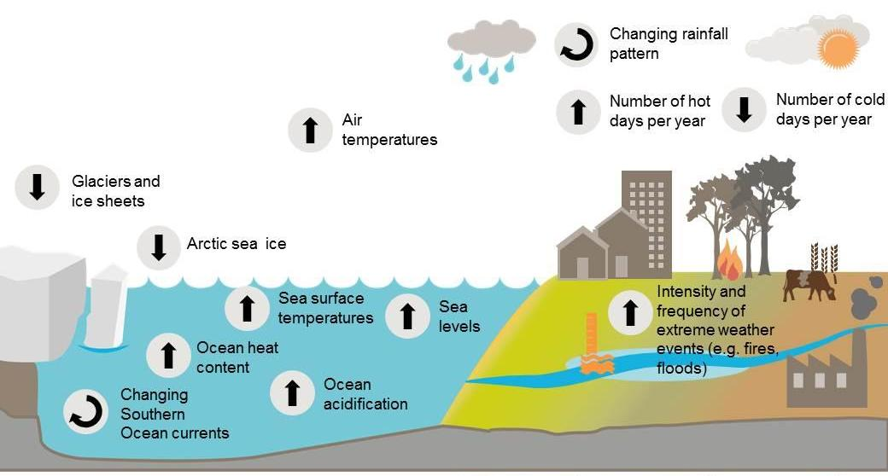
Multiple indicators – climate change

Slide 6
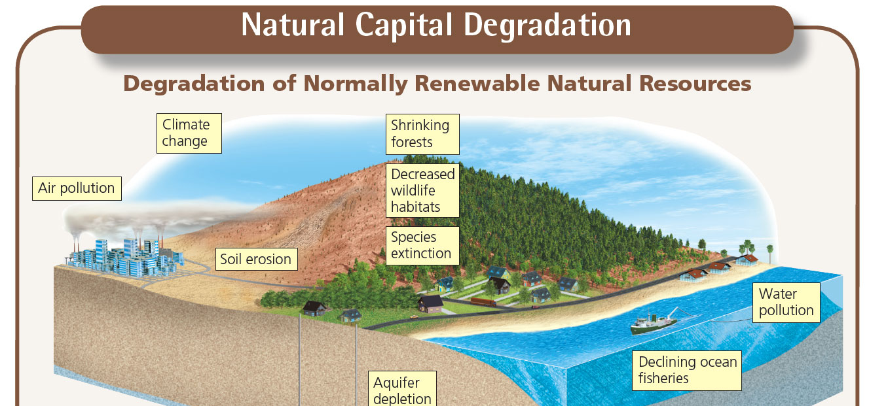

Slide 7
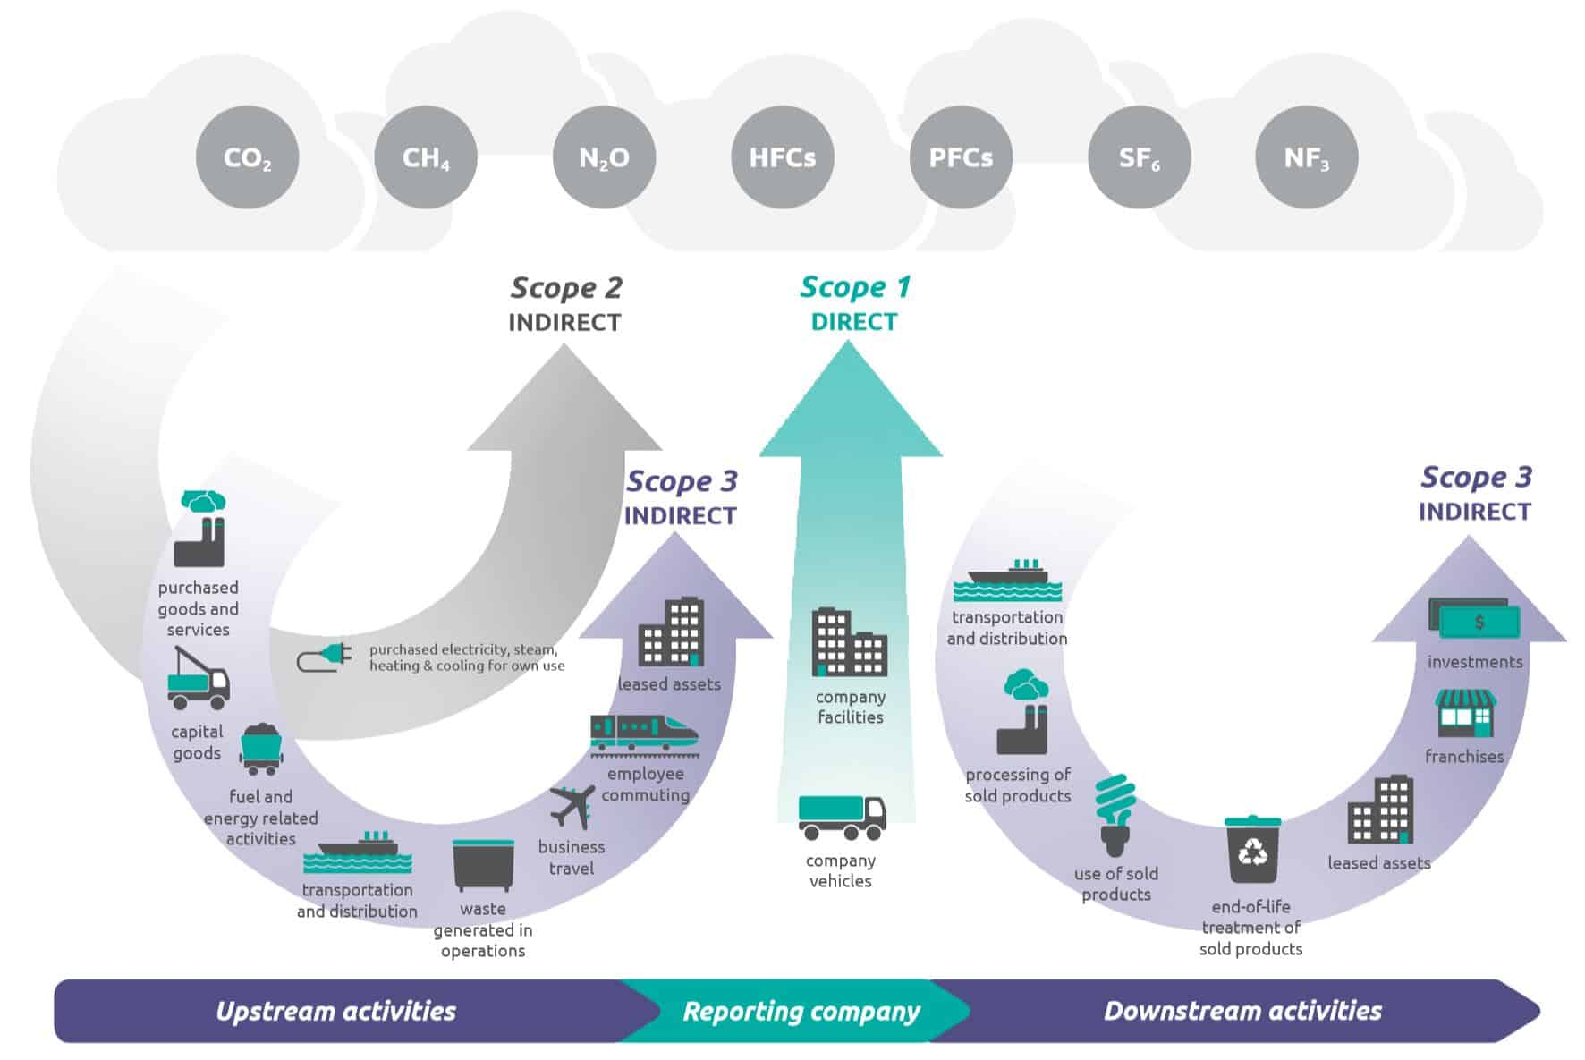
Categorisation of GHG Emissions
Scope 1 – All Direct Emissions from the activities of an organization or under their control. Including fuel combustion on site such as gas boilers, fleet vehicles and air-conditioning leaks.
Scope 2 – Indirect Emissions from electricity purchased and used by the organisation. Emissions are created during the production of the energy and eventually used by the organisation.
Scope 3 – All Other Indirect Emissions from activities of the organisation, occurring from sources that they do not own or control. These are usually the greatest share of the carbon footprint, covering emissions associated with business travel, procurement, waste and water.
IOCL strives for reduction in Scope 1 & 2 emissions

Slide 8
COP-26: India’s commitment
To increase Renewable Energy (RE) capacity to 500 GW by 2030.
50% of the country’s energy requirements to be met using RE sources by 2030.
To reduce carbon emission by one 1 billion tonnes between now and 2030.
The carbon intensity to be reduced to less than 45% by 2030.
Achieve net zero emissions by the year 2070.
Focus on Green Grid now…

Slide 9
Supply Chain & its scope
All activities from point of origin to point of consumption till end of life of product
An integrated manufacturing process converting raw material into finished goods and then delivering to customers
Collection of producers, suppliers, distributors, retailers, information and service providers involved in delivery to customers
From supplier’s supplier to customer’s customer
Contd..

Slide 10
Supply Chain & its scope (contd)
Supply chain management – an integrating function with primary responsibility for linking major business functions and processes within and across into a cohesive and high performing business module
Logistics deals with flow and storage of goods (physical dimensions)
Players : Suppliers, Vendors, Transporters, 3/4PL, customers, manufacturers, service providers, workers, storekeepers, security staff, drivers
Activities : Inbound, outbound, warehouse, production, distribution, retailing, managing value chain, materials, safety, quality, etc.

Slide 11
Greening the Supply Chain
Integration of environmental thinking into supply chain management
Green design (Marketing & Engineering)
Green procurement practices (certified vendors, green products)
Environmental management (pollution prevention, performance measurement, waste elimination)
Green packaging and transportation (reduction, reuse, remanufacturing, recycling and end of life cycle practices)
Measurement and mitigation of scope I, II, III emissions in SCM
Stationery source (material processing, manufacturing and warehousing)
Non-stationery source (inbound and outbound logistics)
Environmental management approaches (ISO 14000, TQM, Lean management practices, life-cycle assessment, product design)

Slide 12
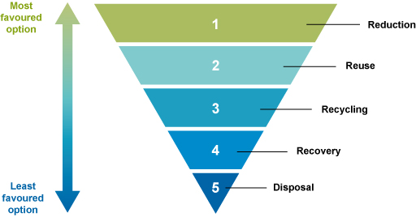
Waste hierarchy

Slide 13
Actionable Areas
Internal
Management commitment
Support of middle management and front liners
Cross functional cooperation for environmental improvement
External
Suppliers and customers
Green warehouses
Green logistics

Slide 14
Internal Focus
Compliance and auditing
Recycled content usages
Material conservation through appropriate designing
Waste elimination and effective recycling
Use only emission-controlled trucks and forklifts
End of life solutions for products
Efficient reverse logistics
Water and energy use sensitivities
Display numbers

Slide 15
External Focus
Design specs to suppliers covering environmental requirements
Substitute of commodity items with sustainable equivalents
Sourcing material with higher recycle content
Recycled packaging material
Cooperate with customers and suppliers for eco-design, clean production and green packaging
Site selection for warehouses, preserving plants and wildlife
Recycling, rainwater harvesting and water conservation

Slide 16
External Focus
Heat resistance roof
Efficient MHEs
Material use, waste recovery and reduced inventory
Natural ventilation, lighting and use of LED lamps
Recyclable pallets
Battery operated vehicles for inbound logistics
Green and efficient fuel for transportation and prepare for electric mobility

Slide 17
Emission & offset
Fuel | Unit (CO2e) | Emission factor
Air Travel | Kg/pass-km | 0.229
Rail Travel | Kg/pass-km (D/E) | 0.075
Road travel | kg/ kg of fuel
 | Diesel | 3.19
 | Petrol | 3.09
 | CNG | 2.69
Electricity | Grid | 0.79
DG Set | Diesel | 3.19
Cooking Fuel | kg/ kg of fuel
 | LPG | 2.98
 | Grid Eectricity | 0.79
Waste | kg per kg | 0.289
(Organic/ paper)
A tree is estimated to sequester 20 kg CO2 per year. Estimated life : 30 years; Survival @ Min 50%

Slide 18
Transportation – modes & Emissions
Water (13 – 40g CO2 / TKM)
Coastal, inland water ways
Rail (20 – 40g CO2 / TKM)
Containerized vs. BCN
DFCI
Road (80 – 340g CO2 / TKM)
Efficient, scale of economy, 2 drivers, transshipment opportunities
Electric mobility
Quality highways, expressways, bypasses
Air (600 – 1260g CO2 / TKM)
Urgent requirement, precious cargo, costly

Slide 19
Initiatives at ioc
Renewable Energy – Solar, wind, ROs
Participation in Gas Economy – LNG, PNG, CNG, CGD
SATAT – CBG under Indi-Green
Ethanol Blending in MS
Electric mobility – Charging/ swapping facilities at ROs
Green Hydrogen Plants at Mathura & Panipat
EPR projects for Lubes & Polymer
Waste to value (Gas/ Power/ Biofuels)
Carbon sequestration – Biological/ CCUS
Recycling & Rain Water Harvesting

Slide 20
Best Practices – Supply chain industry
Modal Transition from road to rail
Truck generators to electric power
Cardboard crates to reusable plastic
Sustainability 360, engaging associates, suppliers, communities and customers on environmental footprint, material conservation and packaging improvements
Increase use of recovered material in vehicle production
Recycling guidelines to worldwide suppliers and engineers
Design innovation for use of recycled material
Major purchaser of renewable energy
Deploying wide body plane to reduce fuel consumption
70% recycled fiber used in packaging

Slide 21
Summing Up
Supply chain and sustainability are integral to our existence
Climate change and global warming have reached an alarming trend
Tremendous scope to control GHG emission through efficient and green supply chain
360 deg. actionable areas in terms of elements of chain, players involved and dimensions of activities
Inbound logistics, warehousing and transportation have maximum potential for greening the supply chain
Judicial discretion on multimodal logistics and modal optimization
Efficient use of virtual / digital platform, optimize travel/ physical meets
Need for changed mindset, receptive outlook and go getter attitude.
Thanks

